Slide 1

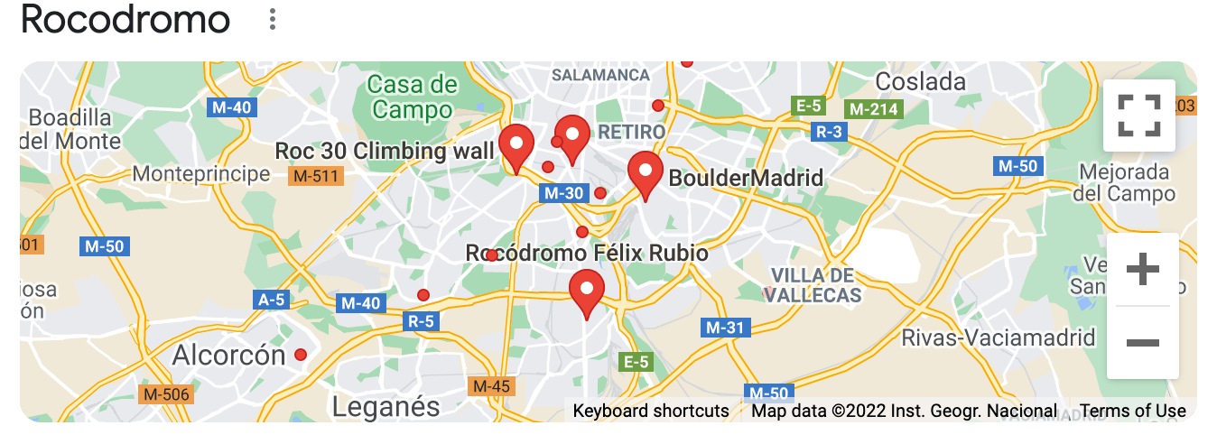
Iron
Climber
Url: /
Url: /logout
Logo
| |
Signup
Log in
Log out
Elige tu zona
Madrid
Barcelona
Lugar 1
Lugar 2
Enviar
API: Google

Slide 2
Iron
Climber
Url: /auth/signup
Logo
NAV BAR | NAV BAR |
Signup
Log in
Log out
Formulario de Registro
Username:
gmail:
Password 1:
Password 2:

Slide 3
Iron
Climber
Url: /auth/login
Logo
NAV BAR | NAV BAR |
Signup
Log in
Formulario de ingreso
Username or gmail
password
ENVIAR

Slide 4

Iron
Climber
Url: /users/:id/details
Logo
NAV BAR | NAV BAR |
Signup
Log in
Log out
Editar
ELIMINAR
PHOTO
PICTURE ACTIVITIES
ClimbType
Biography
level
Favorite places (ul)

Slide 5
Iron
Climber
Url: /users/:id/update
Logo
NAV BAR | NAV BAR |
Signup
Log in
Log out
Editar
ELIMINAR
PHOTO
PICTURE ACTIVITIES
ClimbType
Biography
level
Favorite places (ul)

Slide 6
Iron
Climber
Url: /users/:id/details
Logo
NAV BAR | NAV BAR |
Signup
Log in
Log out
Editar
ELIMINAR
¿Estás seguro que quieres ELIMINAR tu acceso a
IRON DRIVER?
Ingresa Password: *******
PHOTO
PICTURE ACTIVITIES
ClimbType
Biography
level
Favorite places (ul)

Slide 7
Iron
Climber
Url: /places/create
Logo
NAV BAR | NAV BAR |
Signup
Log in
Log out
name
location
enviar

Slide 8
Iron
Climber
Url: /places/:id/details
Logo
NAV BAR | NAV BAR |
Signup
Log in
Log out
Editar
ELIMINAR
name
Image Places
typePlace
placeAccess
level
description
material (ul)
Parking
reviews

Slide 9
Iron
Climber
Url: /places/:id/details
Logo
NAV BAR | NAV BAR |
Signup
Log in
Log out
Editar
ELIMINAR
name
Image Places
typePlace
placeAccess
level
description
material (ul)
Parking
reviews
Ingresar review
AÑADIR REVIEW

Slide 10
Iron
Climber
Url: /places/:id/details
Logo
NAV BAR | NAV BAR |
Signup
Log in
Log out
Editar
ELIMINAR
name
Image Places
typePlace
placeAccess
level
description
material (ul)
Parking
reviews

Slide 11
Iron
Climber
Url: /places/:id/details
Logo
NAV BAR | NAV BAR |
Signup
Log in
Log out
Editar
ELIMINAR
name
¿Estás seguro que quieres ELIMINAR este lugar de
IRON DRIVER?
Ingresa Password: ******* → (ADMIN)
Image Places
typePlace
placeAccess
level
description
material (ul)
Parking
reviews

